Slide 1
Toxic Comments classification
Submitted by: lavleen bhat
Student number: 17210637

Slide 2
Contents (crisp-dm)
Business understanding
Data understanding
Data preparation
Modelling
Evaluation
conclusion

Slide 3
Business understanding
Classify the comments into 6 different labels of toxicity

Slide 4
Data understanding
Two separate files for training and test data
Test data is unlabelled
Target labels
Toxic, Severe toxic, Obscene, Threat, Insult, Identity hate
Number of records: 159571

Slide 5
Data preparation
No null values
Tokenize and vectorize
Up-sampling

Slide 6
modelling
Model 1: Initial classification
Logistic Regression, Linear SVC
Model 2: classification after up-sampling
Logistic Regression
Model 3: classification using lstm after up-sampling
GRU

Slide 7
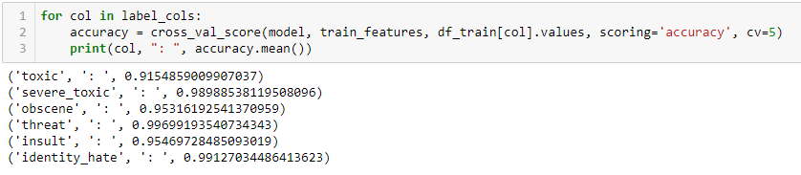
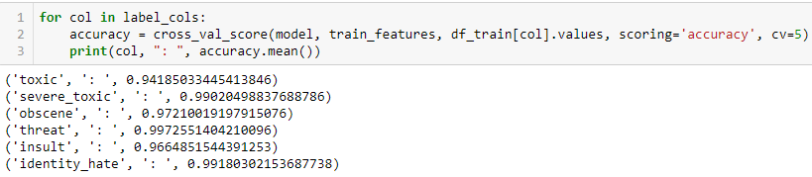
Model 1 – initial classification (Logistic regression)
Accuracy metrics
Unigram
Bi-gram

Slide 8
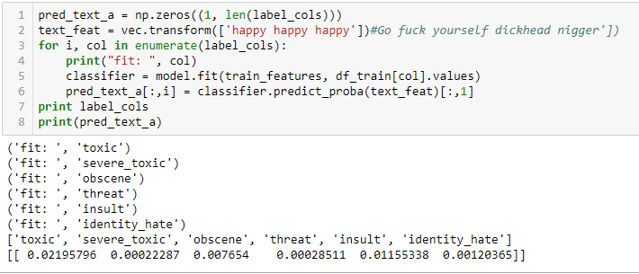
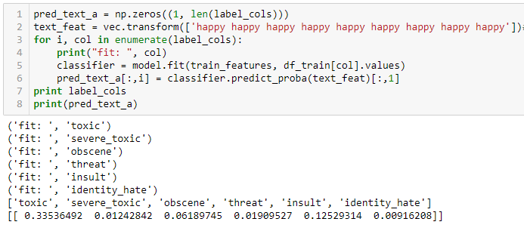
Test on a random text (unigram)

Slide 9
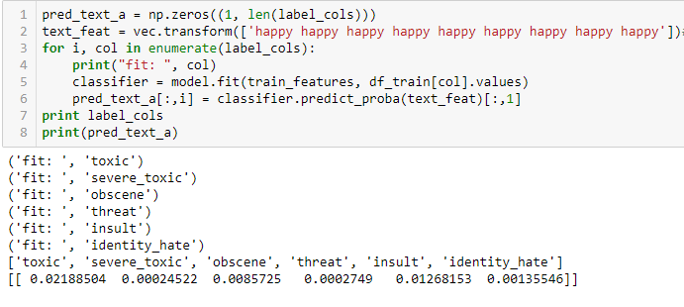
Test on a random text (bi-gram)

Slide 10
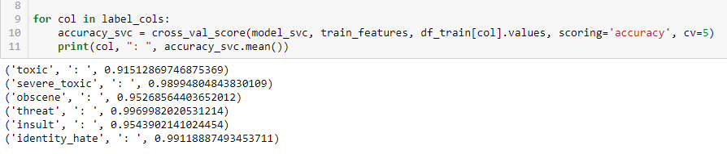
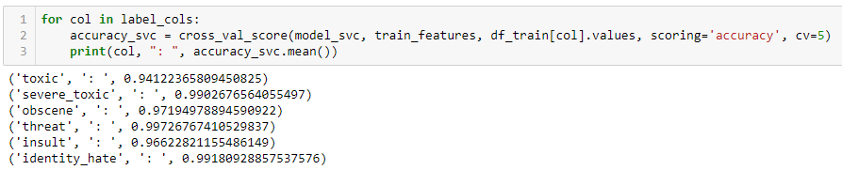
Model 1 – Initial classification (Linear SVC)
Accuracy Metrics
Uni-gram
Bi-gram

Slide 11
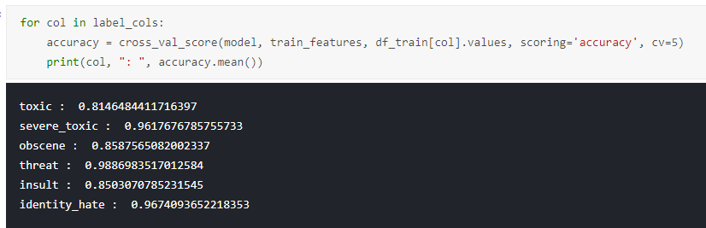
Model 2 – classification after up-sampling
Accuracy metrics

Slide 12
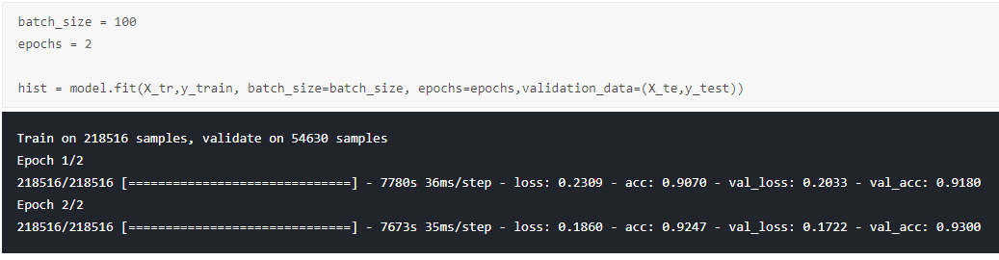
Model 3 – classification using lstm
Accuracy metric

Slide 13
evaluation
Cross validation score - accuracy
Keras model inbuilt accuracy

Slide 14
conclusion
LSTM is better than Logistic Regression and Linear svc

Slide 15
Thank you!

